Slide 1
Neighbourhood Battle
Recommendation for London Tourist

Slide 2
The Problem
As a tourist it is a big task to decide on which all places to visit in a limited amount of time when we are on a trip. It would be of a great help if we know which all places to concentrate so that the time could be efficiently utilized on a trip.

Slide 3
The background
The things to be considered are,
Number of venues
By knowing the number of venues in a particular area the tourist would be able to decide which places to concentrate and how much time to spend on each venue or in a particular area on the trip
Category of Venues
The Concentration based on the category of Venues would be helping the tourist to decide which areas to book a stay on or to spend more time in based on personal interest.

Slide 4
Objective
The intention of this project is to perform a neighborhood analysis on the venues of all the boroughs of London. So that recommendations can be made to a tourist visiting London.
The essence of the analysis would be concentrated on suggesting a tourist which borough or area in London to concentrate on to have most fun in his/her trip.
The Venues would be segregated based on the category and the borough with concentrated venues would be highlighted.

Slide 5
Central London venues
FourSquare API call has been made to get all the relevant venues for the of London city(Central London), 100 venues were obtained for the Central London.
Then the Data has been analyzed and the venues has been segregated into five categories of interest to tourist
Eateries
Historic places
Recreational spots
Shopping venues
Parks and Gardens

Slide 6
Central London venues

Slide 7
Rest of London venues
The venues from rest of London also were obtained from the foursquare API call, 982 venues were returned from the API call.
These venues were also divided into 5 groups which would be of interest to the tourist.
Eateries
Historic places
Recreational spots
Shopping venues
Parks and Gardens

Slide 8
Rest Of London venues

Slide 9
Clustering London Neighbourhood
The London boroughs were clustered with the K means clustering algorithm into 5 clusters.
10 most common venues in each neighborhood has be obtained and listed. Cluster label obtained from the K means algorithm was clubbed with this file with the 10 most common venue details for each borough.
Along with its latitude and longitude details.
Then the venues in the clustered were plotted on a map of London as shown in the image below

Slide 10
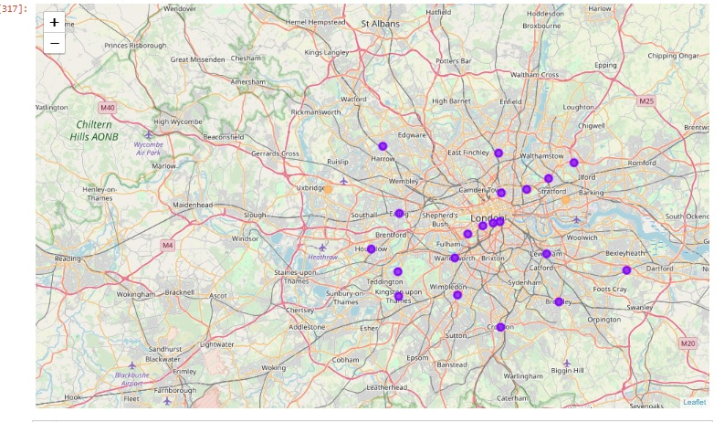
Clustered borough on London map

Slide 11
London borough – Venue count

Slide 12
Conclusion
As per the above plot,
Kingston upon Thames
Southwark
Islington
Ealing
Westminster
Are the boroughs with the greatest number of venues which could interest the tourist other than central London which has 100 venues itself.

Slide 13
Conclusion
Based on the detailed analysis done on the London venues it could be concluded that,
Tourist who are interested in history and heritage could choose to spend time in Central London.
Tourist who are interested in shopping and need a variety of food options could choose among the rest of the London boroughs for their tour.

